Slide 1
Part 9: SVM

Slide 2

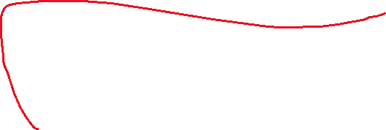
SVM aims to find the best decision boundary (hyperplane) that separates data into different classes with the maximum margin. This helps classify new data points accurately into the correct category.
SVM:
A support vector machine (SVM) is a supervised learning algorithm that performs classification or regression which is based on the margin maximization principle.
Goal of SVM:
The goal of the SVM algorithm is to create the best line or decision boundary that can segregate n-dimensional space into classes so that we can easily put the new data point in the correct category in the future. This best decision boundary is called a hyperplane.
The followings are important concepts in SVM:
Support Vectors − Data points that are closest to the hyperplane is called support vectors. Separating line is defined with the help of these data points.
Hyperplane − It is a decision plane or space which divides a set of objects having different classes.
Margin − It is defined as the gap between two lines on the closest data points of different classes. It can be calculated as the perpendicular distance from the line to the support vectors.
Among the possible hyperplanes, we select the one where the distance of the hyperplane from the closest data points (the “margin”) is as large as possible.

Slide 3
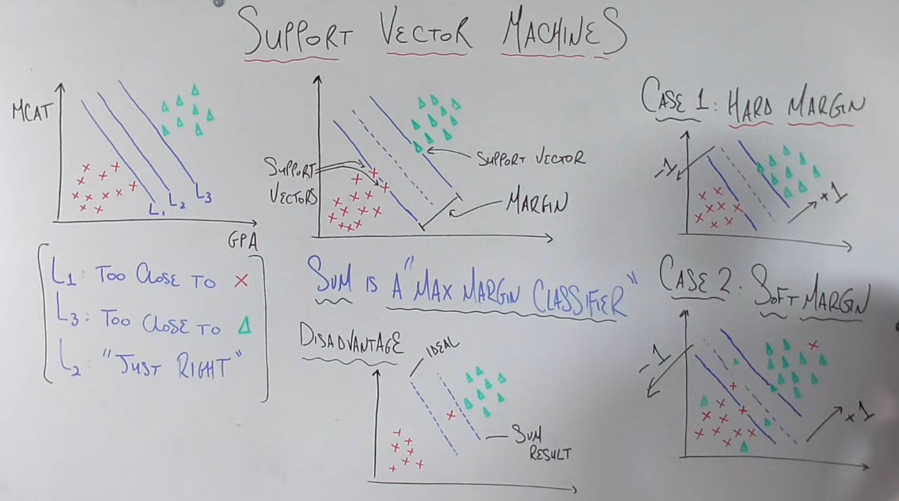

Slide 4
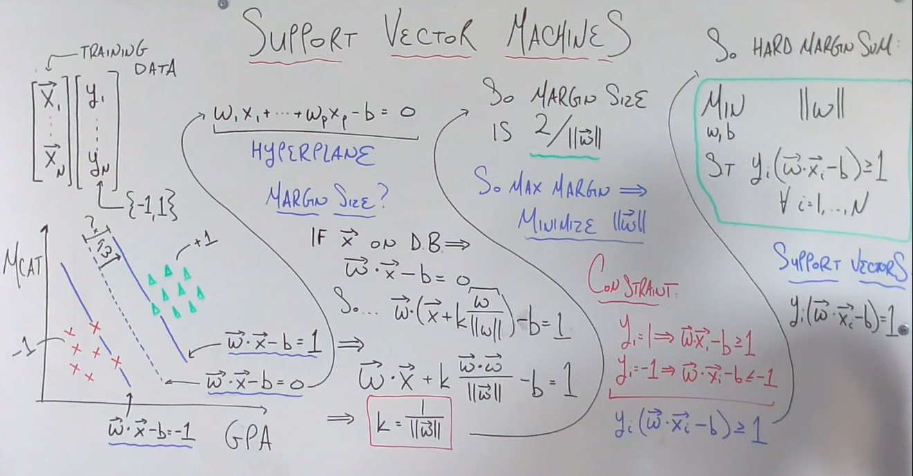

Slide 5
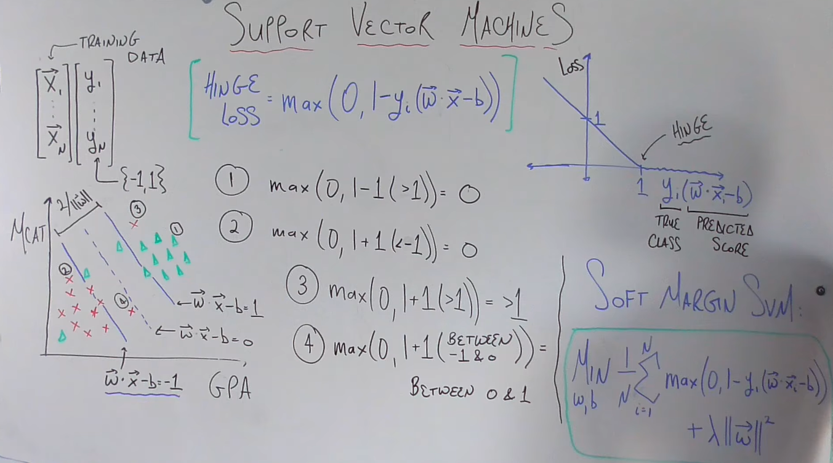

Slide 6
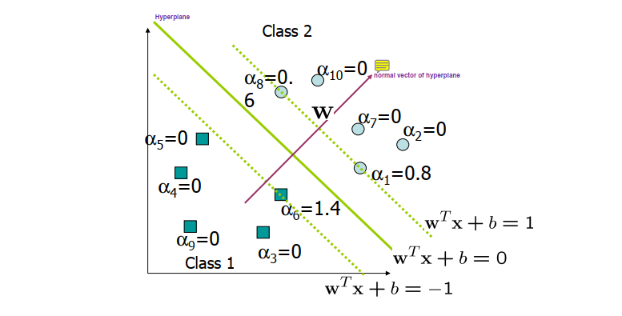

Slide 7
Kernel Function:
Kernel function converts data from input space(lower dimensional space) to feature space(higher dimensional space) to make them linearly separable.
It computes the similarity of two data points in the feature space using dot product.
The following kernels are commonly used: 1. Dot product kernels: K(x_{i}, x_{j}) = x_{i}^{t}.x_{j} 2. Polynomial kernels: K(x_{i}, x_{j}) = (x_{i}^{t}.x_{j} + 1)^{d} 3. RBF kernels : K(x_{i}, x_{j} )= exp( - γ ||x_{i} - x_{j}||²)
Karush–Kuhn–Tucker (KKT) conditions :
Mathematically, the KKT conditions are equations that must be met in order to prove strong duality, which means that the solution to the dual problem will be equivalent to the solution of the primal problem.
When we run the code for SVM, the KKT conditions are going to be the primary reason why all the non-border alphas end up going to 0 and, consequently, the support vectors will be the only alphas > 0.

Slide 8
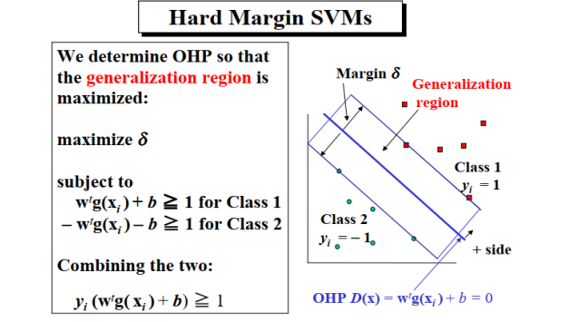
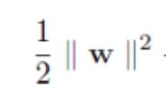
or minimize

Slide 9
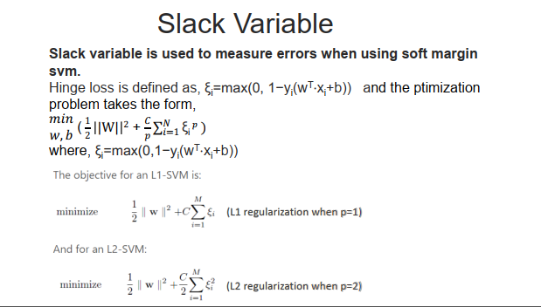

Slide 10
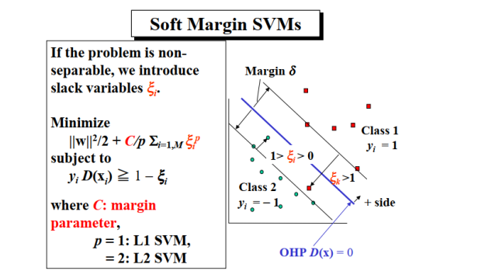

Slide 11
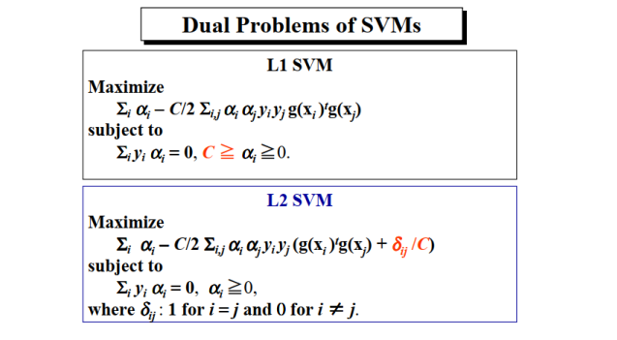

Slide 12
Soft margin VS Hard margin SVM
Soft Margin | Hard Margin
1. Soft margin svm is used when data is not linearly separable in feature space. | 1. Hard margin svm is used when data is linearly separable in fracture space.
2. It allows data points inside the margin | 2. It doesn’t allow data points inside the margin.
3. Soft margin requires cost parameter. | 3. Hard margin doesn’t requires to guess the cost parameter.

